Slide 1


SECURE CAMPUS

Slide 2
Project Team
Muhammad Abuzar (Roll # BCSM-F18-04)
Sheza Ahmad (Roll # BCSM-S19-051)
Rida Fatima (Roll # BCSM-S19-012)
Supervisor: Sir Rizwan

Slide 3
Table of Content
Introduction & Background
Problem Statement
Solution
Features and Scope
Requirements
Use Case Diagram
Functional Requirements
Non Functional Requirements
System Design (Architecture, ERD, Class, Sequence, and Activity Diagram)
Implementation
Challenges
Prototype & Screenshots

Slide 4
Introduction & Background
Campus security is a major problem nowadays.
Campuses need to have the necessary security to proactively prevent any crimes and give everyone a sense of security.
With efficient security system in place, a university can prevent all kinds of violence, immoral and illegal activities on campus.
This is where Secure Campus comes in, where this system will be able to detect anomalies on a live camera.

Slide 5
Problem Statement
Campus security is a significant issue today. Campuses need to have the necessary security to proactively prevent any crimes and give everyone a sense of security. Some students might fall victim to violence and harassment. Things like cigarettes, alcohol, drugs could befall into the hands of the students. Students could be the ones doing some suspicious activity.

Slide 6
Solution
The aim of this project is live surveillance and to detect Violence and sexual harassment that some students fall victim to by using the AI system.
To detect things like cigarettes, alcohol, drug, or any other suspicious activity on live cameras available in the university
Inform the admin/security that suspicious activity has happened, so the quick action should be taken for the safety of the students.

Slide 7
Features and Scope
Following are some of the features and goals of secure campus system:
• Sexual Harassment Detection
• Real-time Calamity Detection (Flood and Earthquake)
• Fire Detection
• Violence detection
• Theft detection
• Cigarettes detection
• Alcohol detection
• Drunk Classification

Slide 8
Requirements
Elicitation Techniques / Tools
Interview
Document Analysis/Review
Brainstorming
Observation
Specification / Documentation
SRS (Software requirements specification)
Notes:
What is elicitation process?
Simply put, elicitation is the process of discovering the requirements. In particular, elicitation often refers to engaging with stakeholders to understand their needs and expectations when it comes to the scope and detailed requirements of the project.

Slide 9
Requirements
List of Different Users
A CCTV operator / Security.
Local Developers.
Use Cases
Functional & Non Functional Requirements

Slide 10
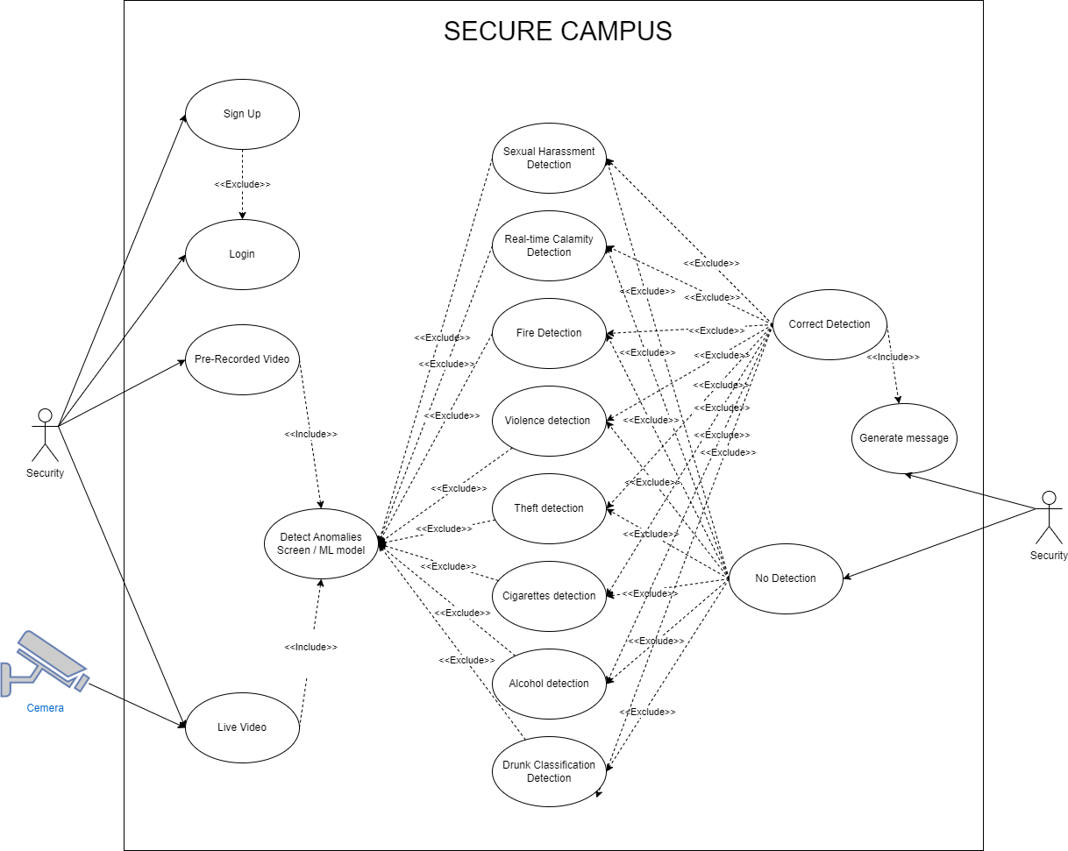
Use Case Diagram

Slide 11
Functional Requirements
Feature | Functional Requirements
Sexual Harassment Detection | Physical acts of sexual assault.
Calamity Detection | Floods Earthquakes
Fire Detection | Fire Smoke
Violence detection | Fighting
Theft detection | Guns and Masks
Cigarettes detection | cigarettes Smoke
Alcohol detection | Alcohol Bottles
Drugs detection / Drunk Classification | Drunk person
Notes:
A functional requirement defines a function of a system or its component
I5 3rd generation minimum
16 GB RAM
Windows 10
Python installed

Slide 12
Non Functional Requirements
Non Functional Requirements | Details
Performance Requirements | Fast Camera for effective detections. HD resolution of the camera. Specified Computer/Minimum mentioned Hardware.
Safety Requirements | ML model does not have 100% results, so the detection results will be given to a real person to judge.
Security Requirements | The system is developed for the security purposes but the system itself is not guarded by the malicious activities.
Usability Requirements | Who: Any anomaly happens by a person. What: unlawful act. When: whenever an anomaly happens. Where: In the university or where the system is installed. Why: To make the organization more secure.
Notes:
non-functional requirement is a requirement that specifies criteria that can be used to judge the operation of a system
Usability requirements are documented expectations and specifications designed to ensure that a product, service, process or environment is easy to use.

Slide 13
Non Functional Requirements
Non Functional Requirements | Details
Reliability Requirements | The reliability requirements of the system are to ensure that any faults do not lead to system failure.
Maintainability/Supportability Requirements | The system itself calculate the efficiency and the low percentage will get rejected by the system while the high efficiency percentage will be detected by the system.
Portability Requirements | The system will be portable as long as the hardware/software requirements met.
Efficiency Requirements | The efficiency of the system will be affected by the change in Hardware. Better Hardware = Better speed and efficiency
Domain Requirements | Availability: This deep surveillance system will only run when the central system/network/cameras are available
Notes:
non-functional requirement is a requirement that specifies criteria that can be used to judge the operation of a system

Slide 14
System Design
Architecture Design
Entity Relationship Diagram
Class Diagram
Sequence / Collaboration Diagram
Activity Diagram

Slide 15
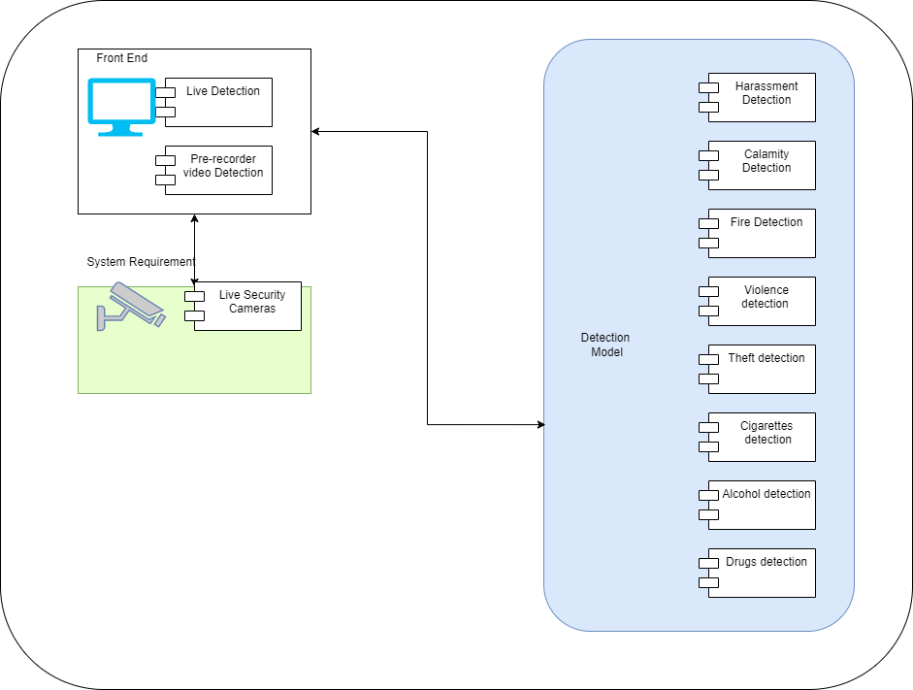
Architecture Design

Slide 16
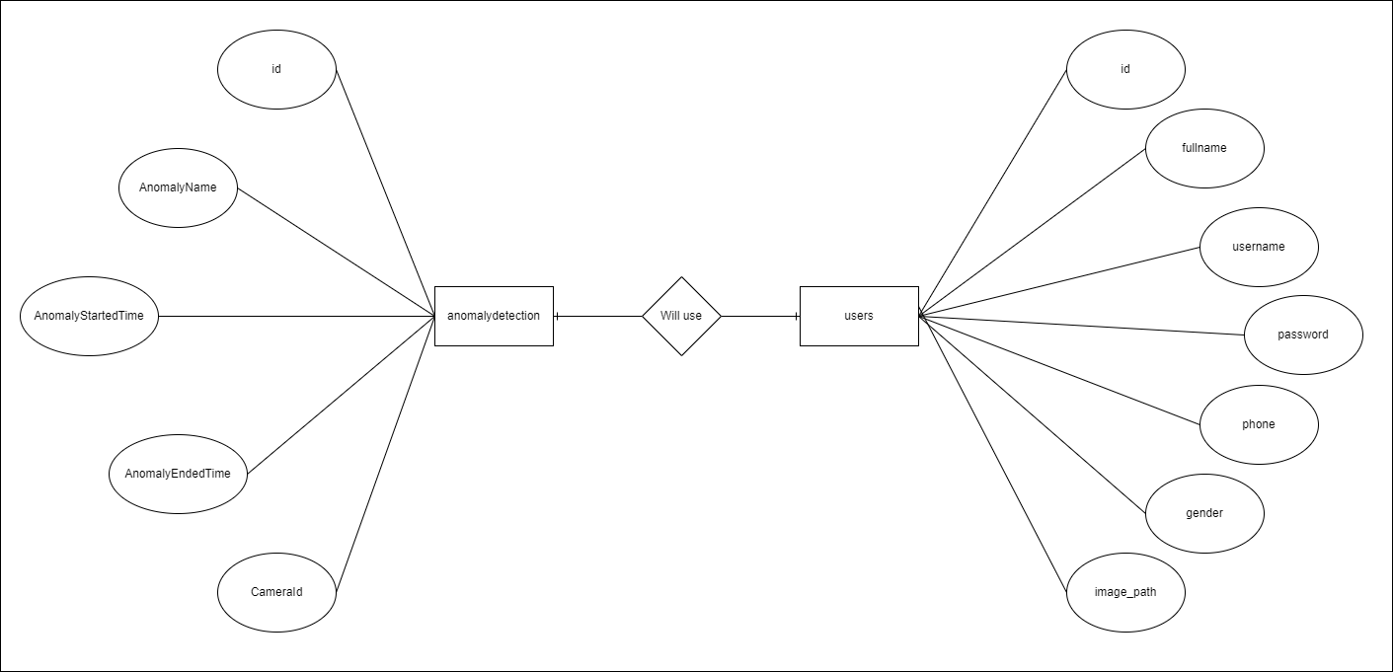
Entity Relationship Diagram

Slide 17
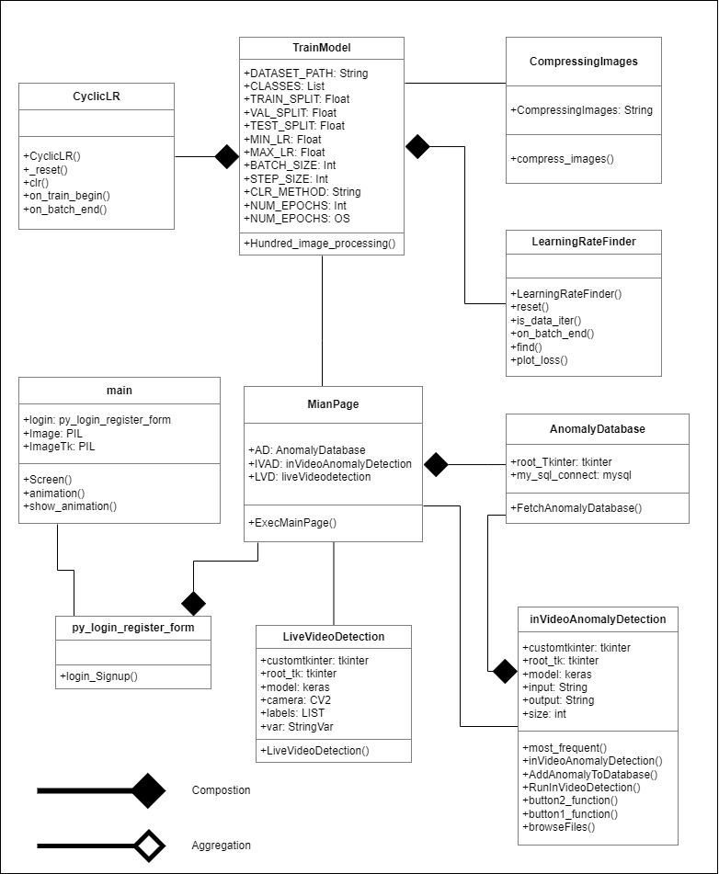
Class Diagram

Slide 18
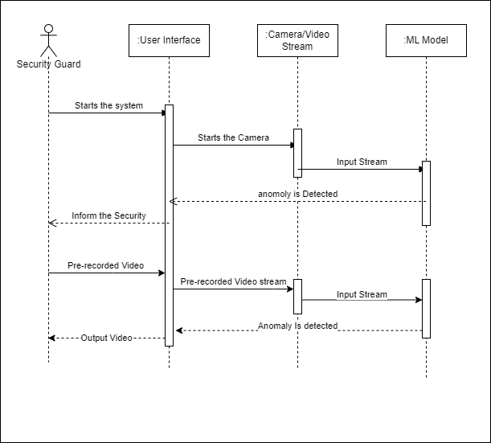
Sequence / Collaboration Diagram

Slide 19
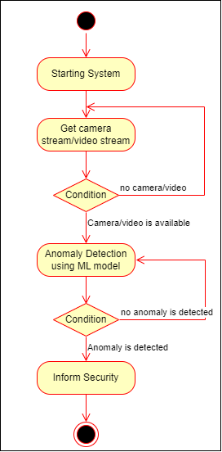
Activity Diagram
Full View
Zoom in view
Get

Slide 20
Implementation
Development Tools & Technologies
Tools:
Pycharm, Google Colab
Languages:
PYTHON
Best Practices / Coding Standards
• Writing comments and documentation.
• Writing readable yet efficient code.
• Using helper methods.
Libraries / Components / Web Services
Components:
Cameras for the live detection system.
Personal Computer (PC) for the secure campus system to run.
Libraries:
OpenCV, TensorFlow, keras, NumPy
Web Services:
24-hour access to security, Efficient, Fast, Consistency

Slide 21
Challenges
Not enough training data.
Poor Quality of data.
Complex coding.
Creating ML Model.
Notes:
Garbage in Garbage out

Slide 22


Final Project
The Project has been created for using Python and Pycharm as IDE.

Slide 23
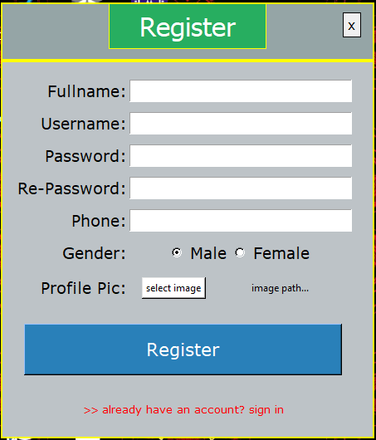
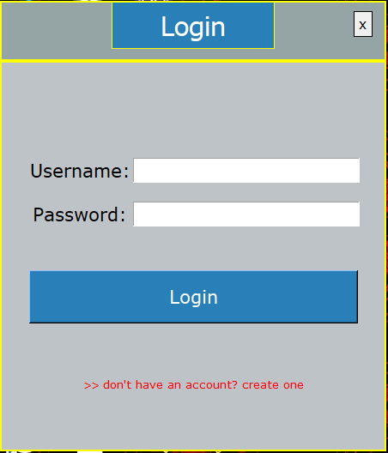
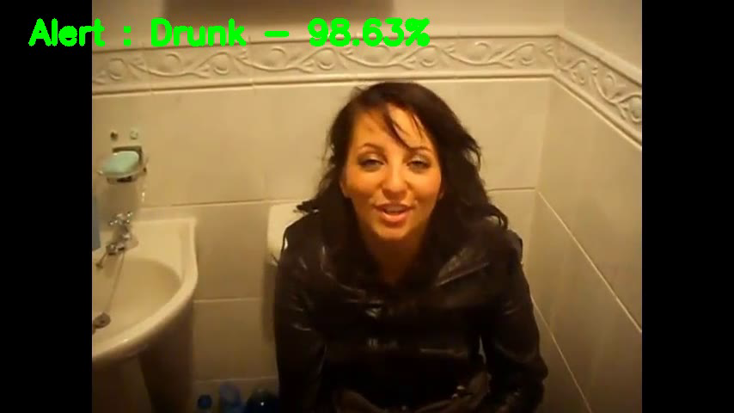
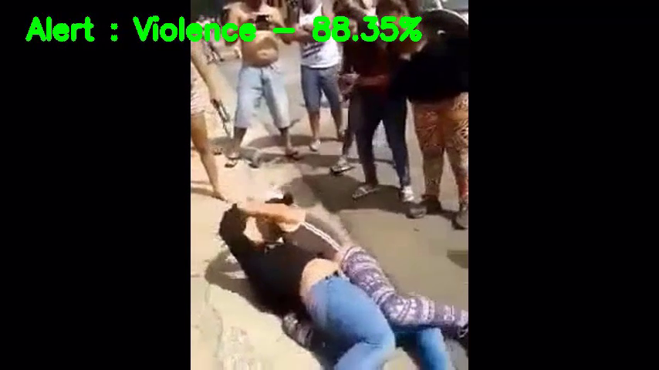
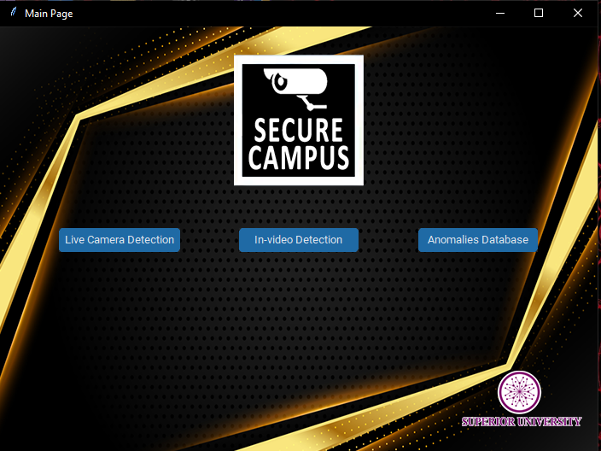
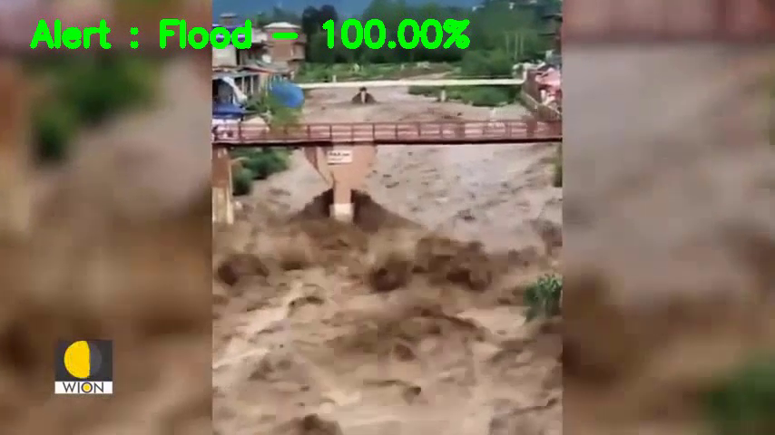
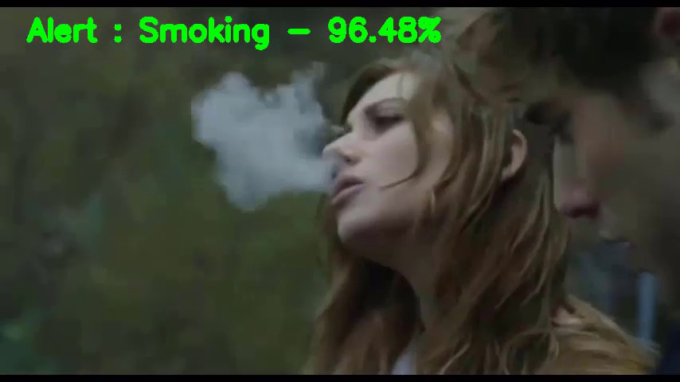
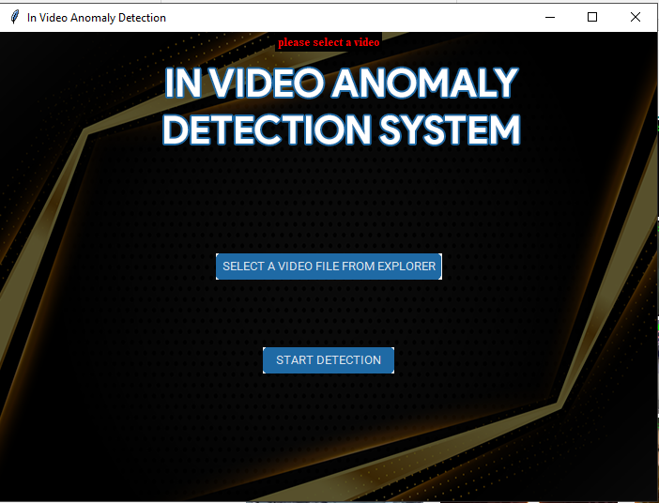
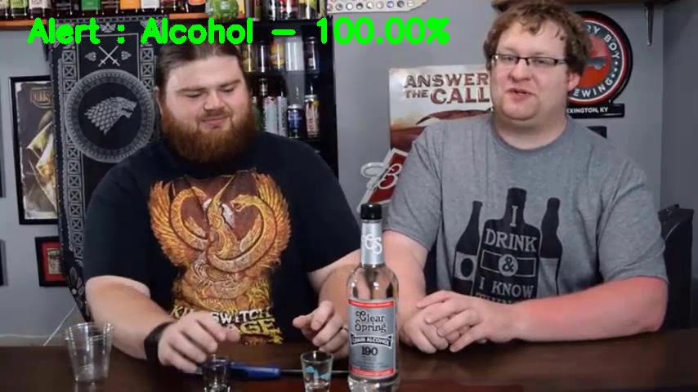
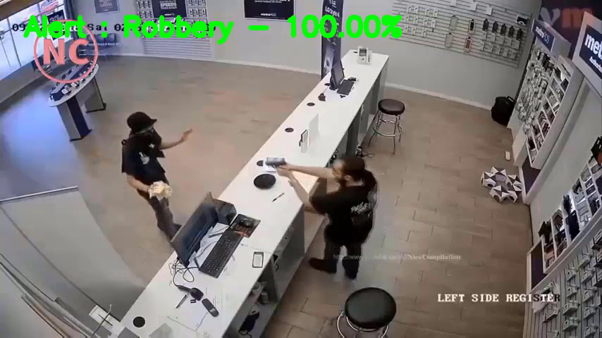
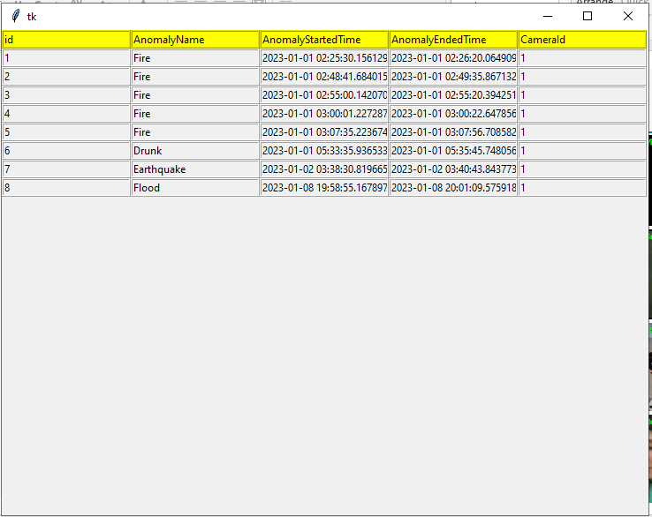
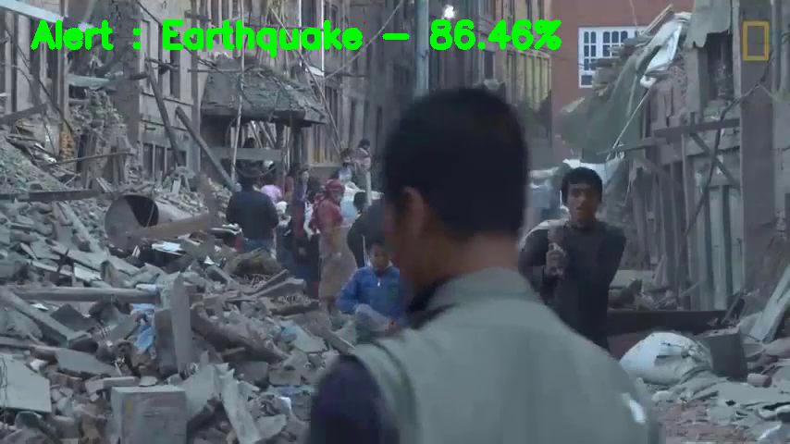
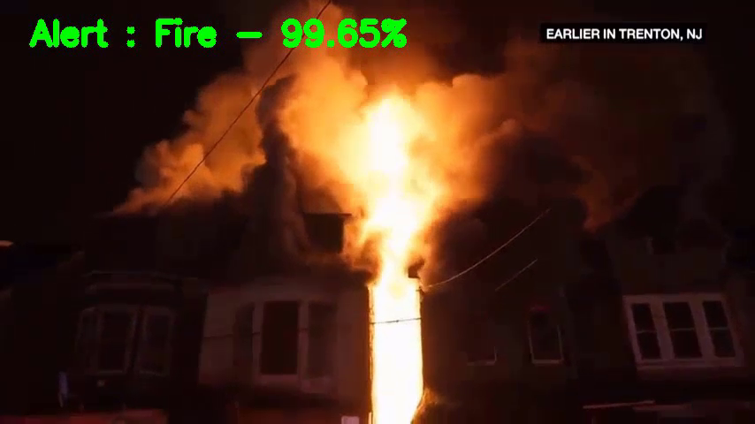
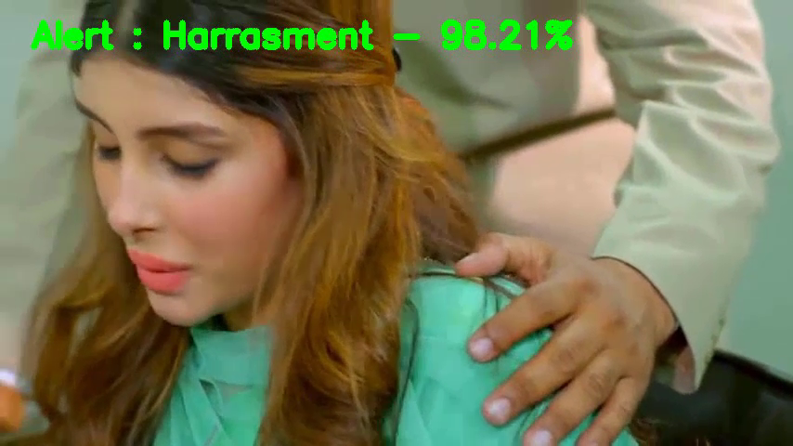
Screenshots

Slide 24
Report
Link to report
https://drive.google.com/file/d/19-VsLswbl7CsrFH5wwqHD-GaaPvT9KEf/view?usp=sharing

